Slide 1


Pharmacy Network Adequacy
PBM PTNP Classification Governance
09:00 am-10:00 am Central
January 6, 2026
Regulatory Health Link Division,
Arkansas Insurance Dept., Dept. of Commerce

Slide 2
Agenda
Intended Audience.
The PTNP:
  Addressing What? Who? Why? Where? How? When?
Direct validation needed with the pharmacy
Suggested strategy on engagement in the PTNP process.
Data Exchange in the PTNP process versus PBM annual data.
New Reporting Data Specifications document.
New PBM data reporting template.

Slide 3
Intended Audience.
Network Adequacy is complex. Needs multidisciplinary teamwork.
AID attempts to communicate with three roles involved in Network Adequacy
  NA Subject Matter Expert (NA SME).
  Associated Data/IT personnel.
  Compliance personnel.

Slide 4
Agenda
Intended Audience.
The PTNP:
  Addressing What? Who? Why? Where? How? When?
Direct validation needed with the pharmacy
Suggested strategy on engagement in the PTNP process.
Data Exchange in the PTNP process versus PBM annual data.
New Reporting Data Specifications document.
New PBM data reporting template.

Slide 5
The PTNP
Addressing
  What? Who?
  Why?
  Where?
  How? When?

Slide 6
What?...is the PTNP? Who?...are involved?
The PTNP is the latest industry consensus on provider classifications. Arrival at this consensus is facilitated by AID.
  The acronym PTNP stands for Provider Type NPI Pools. Think of it as pools of providers assigned to provider types regulated by AID.
This consensus is housed within a spreadsheet published by AID labelled as Current Finalized Provider Type-NPI Pool and referred to as the PTNP for brevity.
The PTNP is updated twice a year by the “PTNP Process”

Slide 7
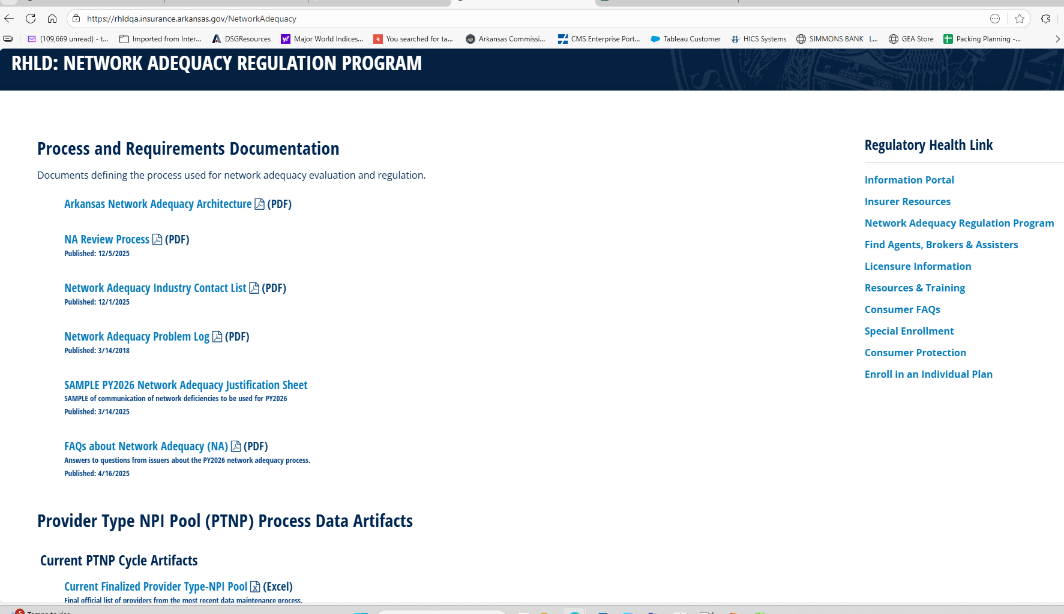
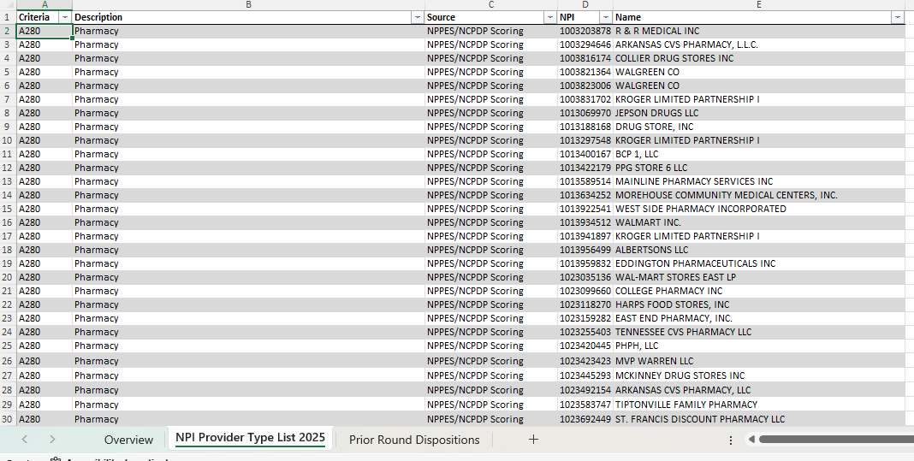
3 tabs
The PTNP

Slide 8
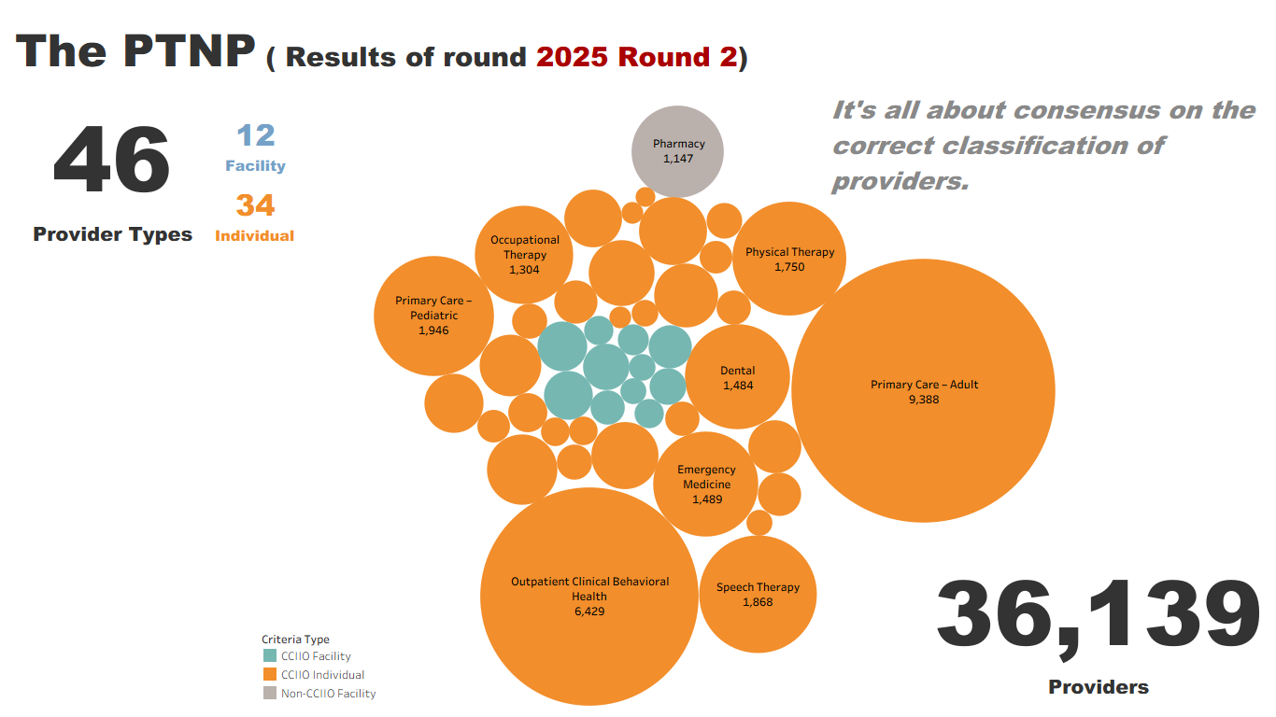

Slide 9
What? (cont’d)
Provider Types are defined in terms NUCC Taxonomy codes.
This definition document is published as a spreadsheet called Provider Type Taxonomic Descriptions (located at https://rhld.insurance.arkansas.gov/NetworkAdequacy).
The definition for Pharmacy has the following but it must vetted as a “Community/Retail Pharmacy”
Taxonomy | Taxonomy Description
333600000X | Pharmacy
3336C0003X | Community / Retail Pharmacy

Slide 10
What? (cont’d)
“But… What’s in it for me?”
Starting in 2026, only pharmacies existing in the PTNP will used in network adequacy computations as retail pharmacies. For example, if an issuer reports 2000 pharmacies in the PLN table in 2026 but the PTNP has 1147 pharmacies, only those among the 2000 pharmacies reported that exist in PTNP will get credit as retail pharmacies towards network adequacy computations.
“So… only worry about retail pharmacy additions? Not removals of incorrect pharmacy types?”
Not quite. Let's understand how Arkansas issues objections.

Slide 11
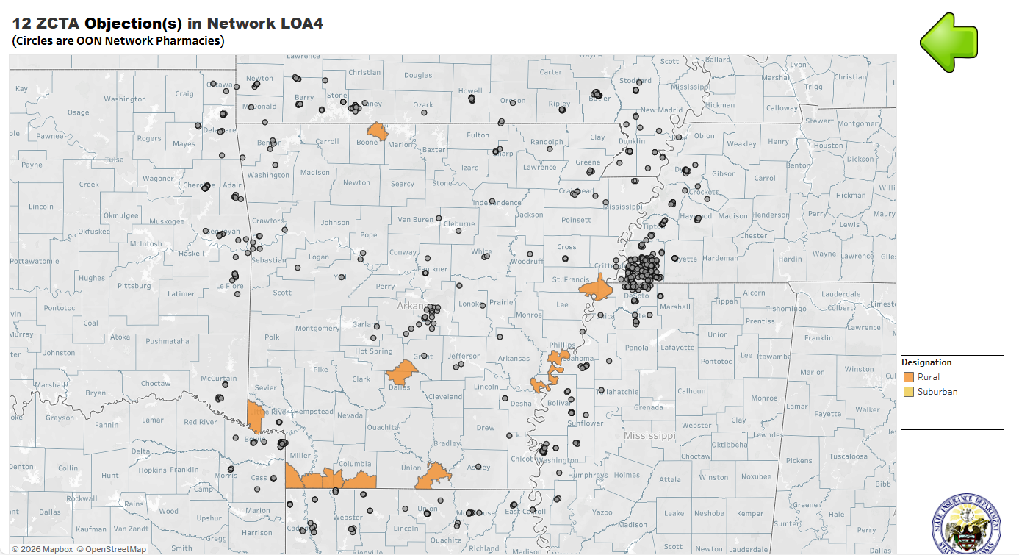
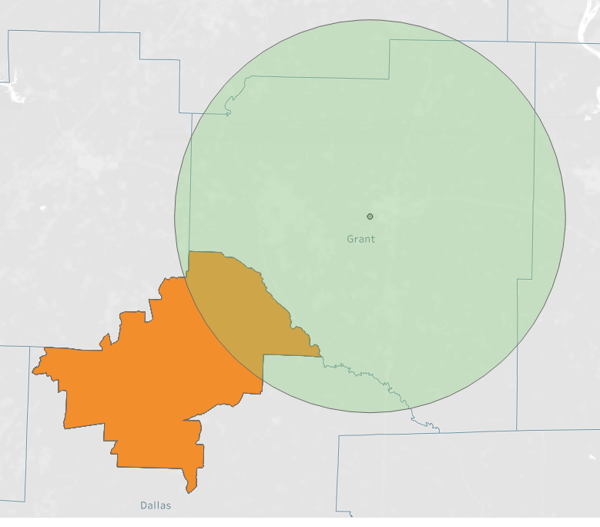
Issuer/PBM “ There aren’t any pharmacies close to our deficiencies “
First question to ask:
“Is this even a retail pharmacy?”
15 miles
Rural ZCTA

Slide 12
What? (cont’d)
AID issues objections for network deficiencies only when both conditions are met
  An issuer is deficient per statutory requirements in a ZCTA and
  Competitive data shows improvement is possible.
Ideal Pharmacy Network:
Deficiencies of each network is compared against an “ideal pharmacy network” built by aggregating pharmacies reported by all issuers that exist in the PTNP.
Reason to remove incorrect classifications:
  You could get an objection because A) the PTNP had a non-retail pharmacy and B) some competitor reported the same pharmacy in the PLN table.
  Your justification should be a commitment to remove the non-retail pharmacy in the next round of the PTNP process.
Once removed from the PTNP, no one gets credit for the invalid pharmacy type.
Bottomline: Keep the PTNP clean and representing only the truth!

Slide 13
The PTNP
Addressing
  What? Who?
  Why?
  Where?
  How? When?

Slide 14
Why?...engage in the PTNP process?
The PTNP provider classification governance process was born in 2015, when industry thought leaders and AID realized that without a common understanding of the classification of providers, evidence-based objective regulation was not possible.
  The NPPES (NPI Registry) classification data was not deemed accurate enough.
In 2024-25, retail community pharmacies did not exist in the PTNP. AID sought to rely on NCPDP retail classifications, based on their reputation as the industry standard. However, some AID objections were contested, and it surfaced that NCPDP retail classifications were not accurate enough (just as with NPPES classifications in the past). This was validated by the Department contacting hundreds of pharmacies determining their retail classification.
Subsequently for 2026 onwards, it was decided to bring retail/community pharmacies back into the PTNP process for more accuracy and ensuring that all issuers/PBM were measured against the same understanding of community/retail pharmacies.

Slide 15
Why? (cont’d)
“Let perfection not be the enemy of the good”
– One of the guiding principles in AID’s Network Adequacy Architecture document.
The PTNP may not be 100% perfect. That is not the goal.
The goal is to be
  BETTER than the NCPDP or NPPES.
  BETTER every round.
  BETTER every year.
BETTER is good.

Slide 16
The PTNP
Addressing
  What? Who?
  Why?
  Where?
  How? When?

Slide 17
Where?...do I locate the PTNP artifacts?
While most PBM pharmacy network adequacy related materials are in the webpage https://rhld.insurance.arkansas.gov/PBMRegulation the PTNP artifacts located in the overarching Network Adequacy Regulation Program homepage https://rhld.insurance.arkansas.gov/NetworkAdequacy .
Provider Type NPI Pool (PTNP) Process Data Artifacts:
  Current Finalized Provider Type-NPI Pool (aka the PTNP)
  <YYYY> Round <N> Initial Provider Type-NPI Pool Template
    For example: 2026 Round 1 Initial Provider Type-NPI Pool Template
  <YYYY> Round <N> Industry Provider Type Addition/Deletion suggestions Template
    For example: 2026 Round 1 Industry Provider Type Addition/Deletion suggestions Template

Slide 18
The PTNP
Addressing
  What? Who?
  Why?
  Where?
  How? When?

Slide 19
How? When? … do I engage in this process?
The PBM PTNP Review Process is a new 2026 document located at https://rhld.insurance.arkansas.gov/PBMRegulation that details how an insurer/PBM could engage in the PTNP process.
It is a step-by-step process document. For each process it details
  The accountable actor for the process.
  The inputs and outputs of the process, down to naming conventions.
  Location to get the inputs and deliver the outputs.
  Date when the inputs are available and outputs are due.
Let’s discover the essence of the document with examples…

Slide 20



How? When? (cont’d)
The Process:
  Two PTNP data maintenance rounds a year
    Each Round is a two-stage process
      Stage 1: Suggestion for classification changes by industry
      Stage 2: Voting on each change by industry
Marks is a LTC pharmacy, not retail.
Druids Pharmacy is not retail.
Add Best Pharmacy?
Remove Druids Pharmacy?
Remove Marks Pharmacy?
Best is a new pharmacy in Jonesboro. Verified!
Insurance Dept.
Suggestions
Issuers
Stage 1
Template

Slide 21
How? When? (cont’d)
The Process:
  Two PTNP data maintenance rounds a year
    Each Round is a two-stage process
      Stage 1: Suggestion for classification changes by industry
      Stage 2: Voting on each change by industry
Agree
Agree
Disagree
Add Best Pharmacy?
Remove Druids Pharmacy?
Remove Marks Pharmacy?
Agree
Insurance Dept.
Votes
Issuers
Stage 2
Template

Slide 22
How? When? (cont’d)
The PTNP collaborative classification is facilitated by AID:
  For each change, AID makes a disposition based on vote counts and/or reason(s). Mostly on vote counts.
  Issuers always encouraged to provide the most evidentiary reason in a concise manner for change suggestions as well as votes.
  AID’s dispositions are transparent.
Agree
Agree
Disagree
Add Best Pharmacy?
Remove Druids Pharmacy?
Remove Marks Pharmacy?
Agree
Insurance Dept.
Votes
Issuers
Stage 2
Template

Slide 23
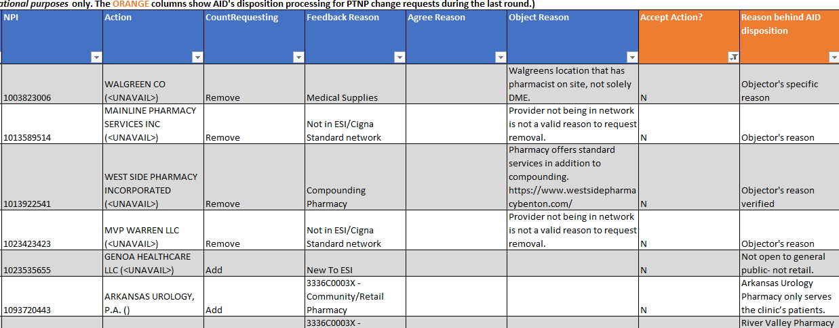
How? When? (cont’d)
The PTNP

Slide 24
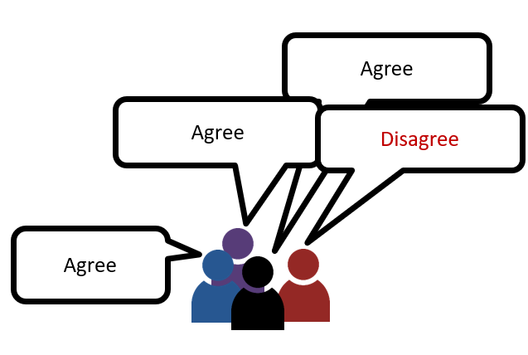
PTNP maintenance timeline: 2026 Round 1
All details available in the PBM PTNP Review Process
Finalized Provider Type-NPI Pool (AID)
Expect: Mar 16, 2026
Initial Provider Type NPI Pool (AID)
Due: Feb 27, 2026
Votes by individual carriers (Issuers)
Expect: Jan 30, 2026
Next up: Jan 15, 2026
Addition-Deletion Suggestions by individual carriers (Issuers)
Industry Provider Type Addition-Deletion suggestions (AID)
Stage 1
Stage 2

Slide 25





http://rhld.insurance.arkansas.gov/Default/NetworkAdequacy
2026 Round 1 Initial Provider Type-NPI Pool
(Available since December 1, 2025)
Add? Delete?
Blue Cross Experts
“20260115_83470_BCBS_Provider_Type_NPI_AddDelete.csv”
(Due Jan 15, 2026)
AID Secure FTP Server
Stage 1: “Suggestion for changes” stage using BCBS as an example

Slide 26


http://rhld.insurance.arkansas.gov/Default/NetworkAdequacy
“2026 Round 1 Industry Provider Type Addition-Deletion suggestions Template" (Expect Jan 30, 2026)
To agree or not to agree on this addition and that removal?
Ambetter Experts
“20260227_80799_Ambetter_ObjectionVote.csv”
(Due Feb 27, 2026)
AID Secure FTP Server
Stage 2: “Voting” stage using Ambetter as an example

Slide 27
Agenda
Intended Audience.
New Reporting Data Specifications document.
The PTNP:
  Addressing What? Who? Why? Where? How? When?
Direct validation needed with the pharmacy
Suggested strategy on engagement in the PTNP process.
Data Exchange in the PTNP process versus PBM annual data.
New PBM data reporting template.

Slide 28
Validation needed beyond secondary sources.
The pharmacy list in the current PTNP was extracted from the NCPDP & NPPES database using a scoring system and has gone through one round of PTNP validation. We are currently in the second round.
Going forward in 2026 and beyond, issuers/PBMs are advised NOT to add pharmacy(ies) into the PTNP list only because they are classified Community/Retail in either of the following databases:
    NPI Registry (NPPES data) or
    NCPDP database.
Instead, take the additional step to verify directly with the pharmacy if they are Community/Retail. It’s a simple two question validation.

Slide 29
Validation needed (cont’d).
Vet pharmacies as Community/Retail. (Their contact number in the NPI Registry is mostly accurate)
Never ask a pharmacy if they are “Retail”. Local/State pharmacy boards may issue a retail license that does not align with Medicare’s interpretation of a Community/Retail pharmacy. Medicare’s interpretation is applicable in PBM regulation.
Contact the pharmacy directly with the questions
  Would you entertain anyone from the public walking into your pharmacy with a valid prescription?
  Do you carry generally the range of medications a Walgreens, Walmart Pharmacy or Kroger Pharmacy would? Or do you only carry specialty medications or equipment.
  The answer to 1) and 2) needs to be “Yes”.

Slide 30
Agenda
Intended Audience.
New Reporting Data Specifications document.
The PTNP:
  Addressing What? Who? Why? Where? How? When?
Direct validation needed with the pharmacy
Suggested strategy on engagement in the PTNP process.
Data Exchange in the PTNP process versus PBM annual data.
New PBM data reporting template.

Slide 31
Suggested PTNP engagement strategy
Don’t boil the ocean, reviewing thousands of pharmacies.
Use business triggers such as (but not limited to)
  Changes in the network
    New pharmacies: If missing in the PTNP, validate as retail & earmark for addition.
    Closed pharmacies: If existing in the PTNP, earmark for removal.
    Changed ownership: Earmark NPI under old management for removal & add NPI under new management for addition.
  Objections received:
    If OON Pharmacies close to or inside the deficient ZCTA is verified as not retail, earmark for removal
    If you have a pharmacy close to or inside the deficient ZCTA that is retail but not in the PTNP, earmark for addition.

Slide 32
Agenda
Intended Audience.
New Reporting Data Specifications document.
The PTNP:
  Addressing What? Who? Why? Where? How? When?
Direct validation needed with the pharmacy.
Suggested strategy on engagement in the PTNP process.
Data Exchange in the PTNP process versus PBM annual data.
New PBM data reporting template.

Slide 33
Data Exchange
(PTNP process versus PBM annual data)
PBM annual data due March 1 | PTNP Process data from insurers
New drag and drop web location from 2026 onwards. Will be activated soon. https://rhld.insurance.arkansas.gov/PBMDataUpload | The document PBM PTNP Review Process currently details legacy file transfer method. A drag and drop web location is planned, and the document will be updated when done so.
 | The legacy file transfer method is to AID’s secure site using sftp protocol. If it appears too complex, simply your data template after validation to the email RHLD.DataOversight@arkansas.gov.

Slide 34
Agenda
Intended Audience.
New Reporting Data Specifications document.
The PTNP:
  Addressing What? Who? Why? Where? How? When?
Direct validation needed with the pharmacy.
Suggested strategy on engagement in the PTNP process.
Data Exchange in the PTNP process versus PBM annual data.
New PBM data reporting template.

Slide 35
Reporting Data Specifications document.
This document has been revamped.
Explaining
  New templates.
  The relationship between annual data submitted on March 1, with the PTNP Process, starting 2026 and beyond.

Slide 36
New PBM data reporting template.
One template.
  Multiple data tabs instead of multiple templates with a single data tab.
Exact same data - Except we are dropping NAIC Code required as the first column of every table in the past.
Validation incorporated for common errors found in the past.
  Templates must be validated and free of errors before submission.
Template details published in PBM Network Adequacy web-location: https://rhld.insurance.arkansas.gov/PBMRegulation

Slide 37
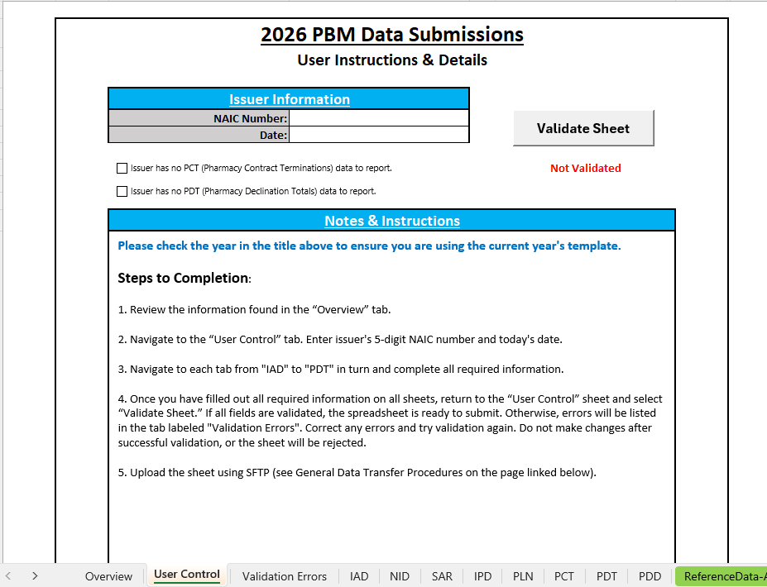
New PBM Data Template
Validation Button
Checkbox for optional data tabs
Multiple tabs

Slide 38
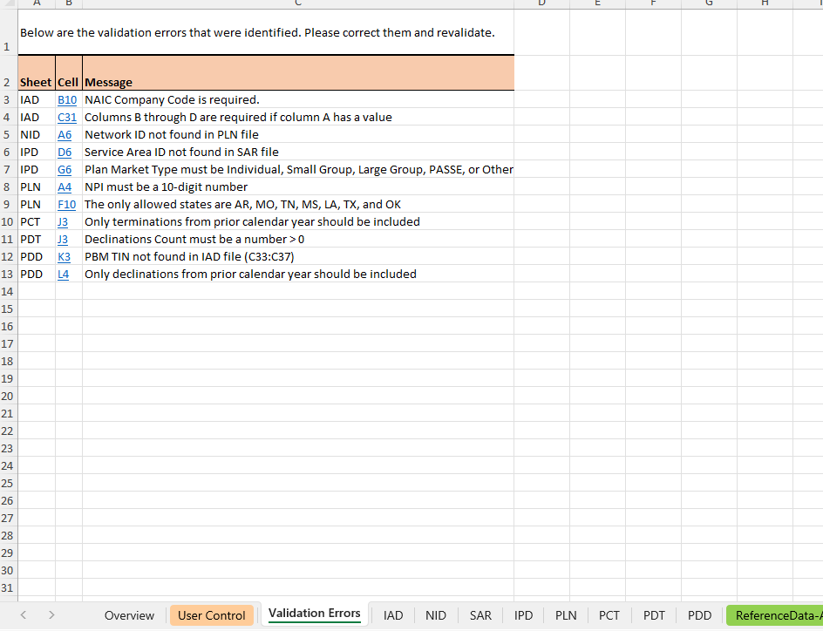
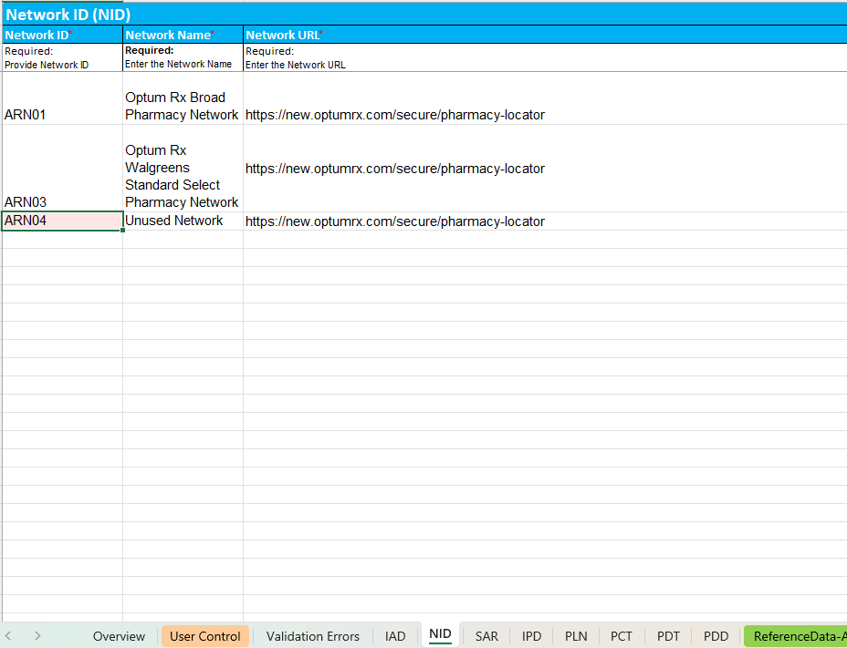
Validation Errors tab (in case of errors)
Upon clicking on the cell

Slide 39


Questions?
Email
RHLD.DataOversight@arkansas.gov

